Slide 1





6-5 ASYNC() AND AWAIT() with Spheros
HARIKA NAIDU
Sai Tejaswini Narne
MEHAR CHOUDHARY MEENAVILLI
SAIKUMAR NALIVELA
Jacob Mccullough

Slide 2
Introduction
In Javascript, we often need to deal with asynchronous behavior, which can be confusing for programmers who only have experience with synchronous code.
Our presentation will explain what asynchronous code is, what are promises, how async() and await() functions are introduced and how to use them with the help of a sphero.
MEHAR CHOUDHARY MEENAVILLI

Slide 3
Is javascript Synchronous or Asynchronous?
Some might say its synchronous and some might say asynchronous and some might say its both because of blocking code, non-blocking code and event-driven programming.
But its actually synchronous programming. Due to the call backs in javascript it looks like asynchronous.
MEHAR CHOUDHARY MEENAVILLI

Slide 4
SYNCHRONOUS
It waits for each operation to complete, after that only it executes the next operation
ASYNCHRONOUS
It never waits for each operation to complete, rather it executes all operations in the first GO only.
MEHAR CHOUDHARY MEENAVILLI

Slide 5

promises
MEHAR CHOUDHARY MEENAVILLI

Slide 6
Promises IN JAVASCRIPT
A promise is a special JavaScript object that links the “producing code” and the “consuming code” together.
The “producing code” takes whatever time it needs to produce the promised result, and the “promise” makes that result available to all of the subscribed code when it’s ready.
When the promise is created, this executor function runs automatically. It contains the producing code, that should eventually produce a result.
MEHAR CHOUDHARY MEENAVILLI

Slide 7
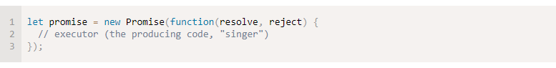
Constructor Syntax for promise object
The function passed to new Promise is called the executor.
The resulting promise object has two properties:
State - Fulfilled or Rejected or Pending
Result – initially undefined
MEHAR CHOUDHARY MEENAVILLI

Slide 8
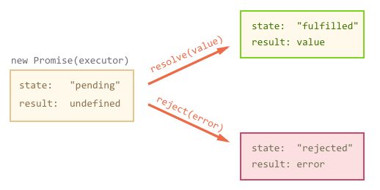
When the executor finishes the job, it should call one of the functions that it gets as arguments:
resolve(value) — to indicate that the job finished successfully:
sets state to "fulfilled",
sets result to value.
reject(error) — to indicate that an error occurred:
sets state to "rejected",
sets result to error.
MEHAR CHOUDHARY MEENAVILLI

Slide 9
Enhancement in promises
Due to many lines of code that is present, it makes programmer confusing and its also difficult to find errors if occurred.
So, they came with an enhancement i.e. using of async() and await() functions.
MEHAR CHOUDHARY MEENAVILLI

Slide 10
What are asynchronous functions?
Async and await are the extensions of promises.
An asynchronous function is a function which operates asynchronously via the event loop, using an implicit Promise to return its result. But the syntax and structure of your code using async functions is much more like using standard synchronous functions.
SAIKUMAR NALIVELA

Slide 11
If we break the definition:
The function operates asynchronously via event loop.
It uses an Promise object to return the result.
The syntax and structure of the code is similar to writing synchronous functions.
SAIKUMAR NALIVELA

Slide 12

An async() function can contain an await expression that pauses the execution of the async function and waits for the passed Promise's resolution, and then resumes the async function's execution and returns the resolved value. Remember, the await keyword is only valid inside async functions.
SAIKUMAR NALIVELA

Slide 13
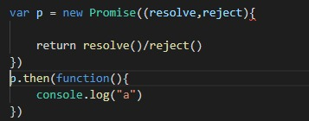
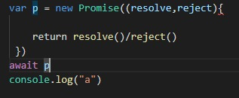
advantage of using Async and await over promises
Code looks simple and easy to understand
SAIKUMAR NALIVELA

Slide 14
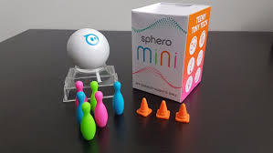


Introducing the Sphero Mini
Small
Colorful
Programmable
Fun
Jacob Mccullough

Slide 15

Setting up Sphero edu
Jacob Mccullough

Slide 16
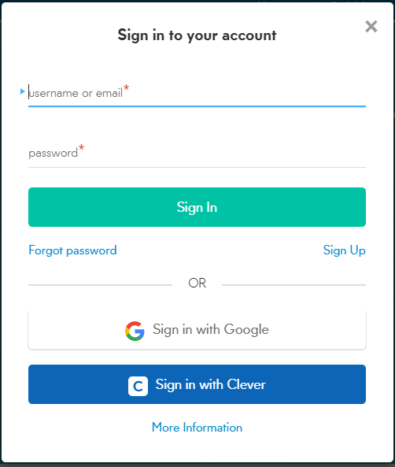
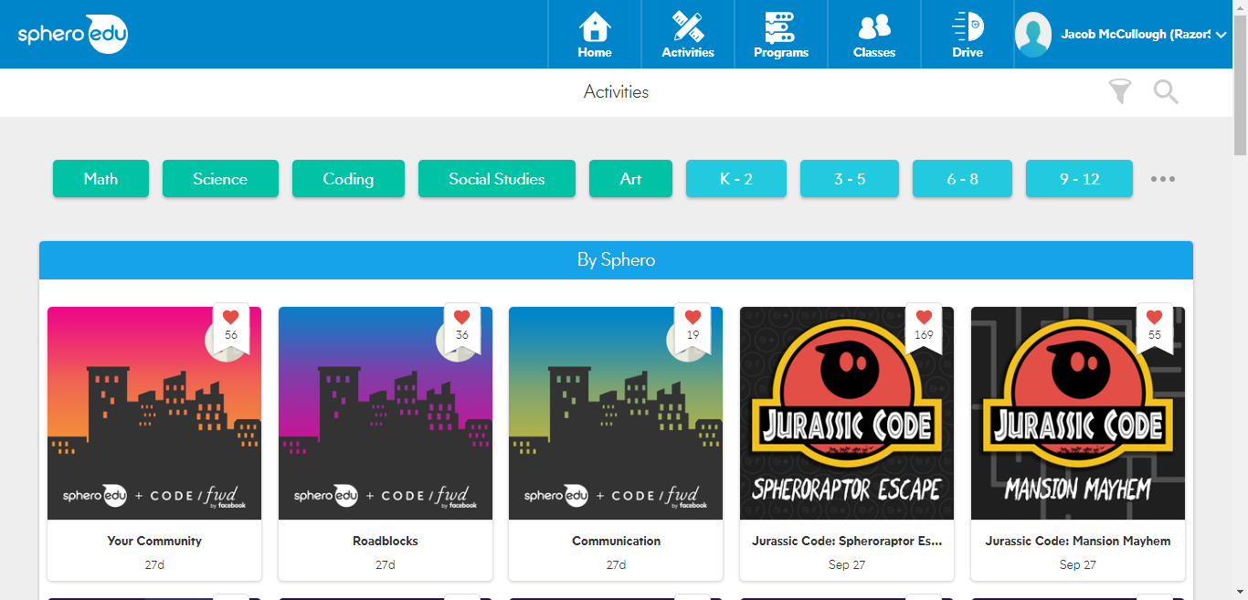
Getting Started
Jacob Mccullough

Slide 17
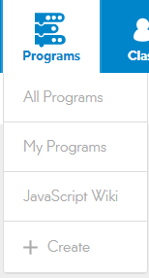
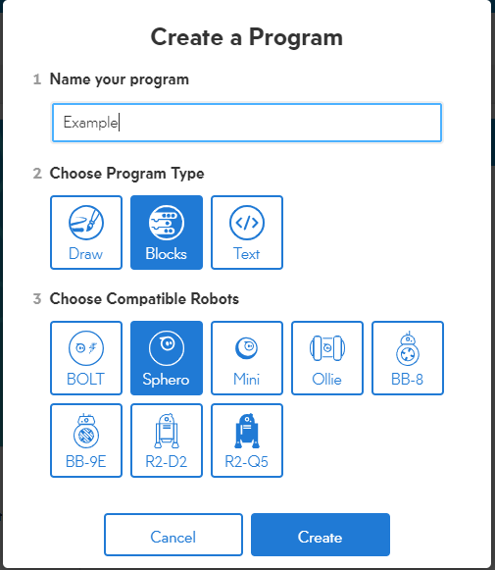
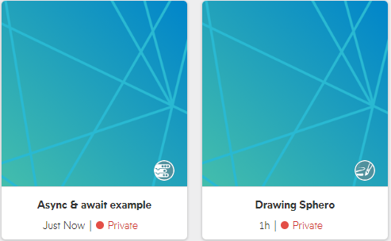
Creating a program
Jacob Mccullough

Slide 18

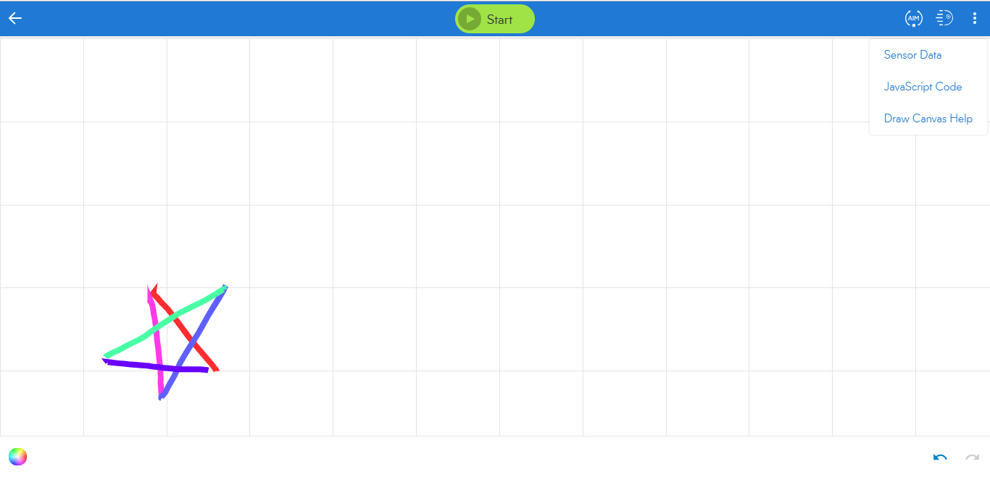
Drawing
Jacob Mccullough

Slide 19
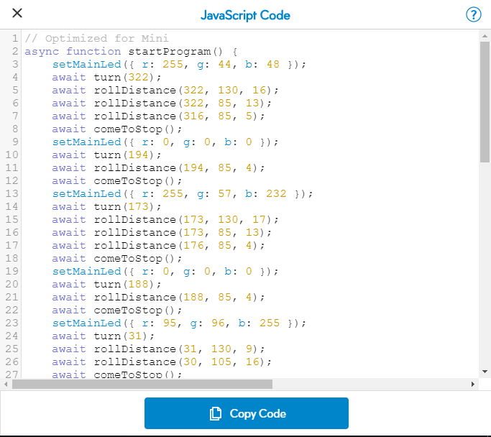
The Code
Jacob Mccullough
Jacob Mccullough

Slide 20
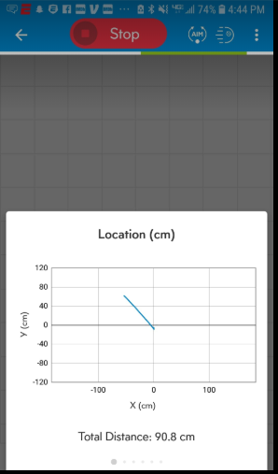
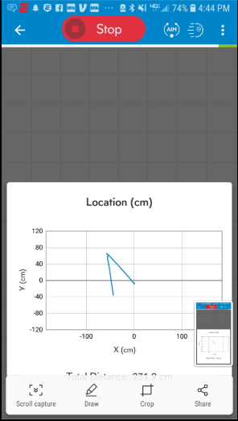
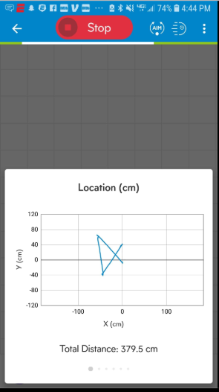
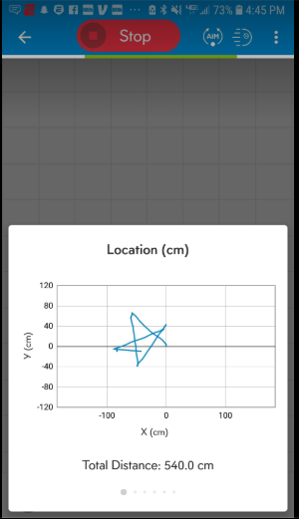
Location Map
Jacob Mccullough

Slide 21
Functions used IN JAVASCRIPT CODE
roll(direction, speed, time in sec)
Speak('Text',true)
setMainLed(r: 0,g: 100,b:0)
delay(time)
Harika Naidu

Slide 22
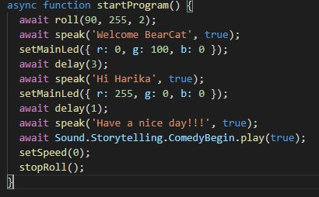
Sphero mini using text (javascript code)
Harika Naidu

Slide 23
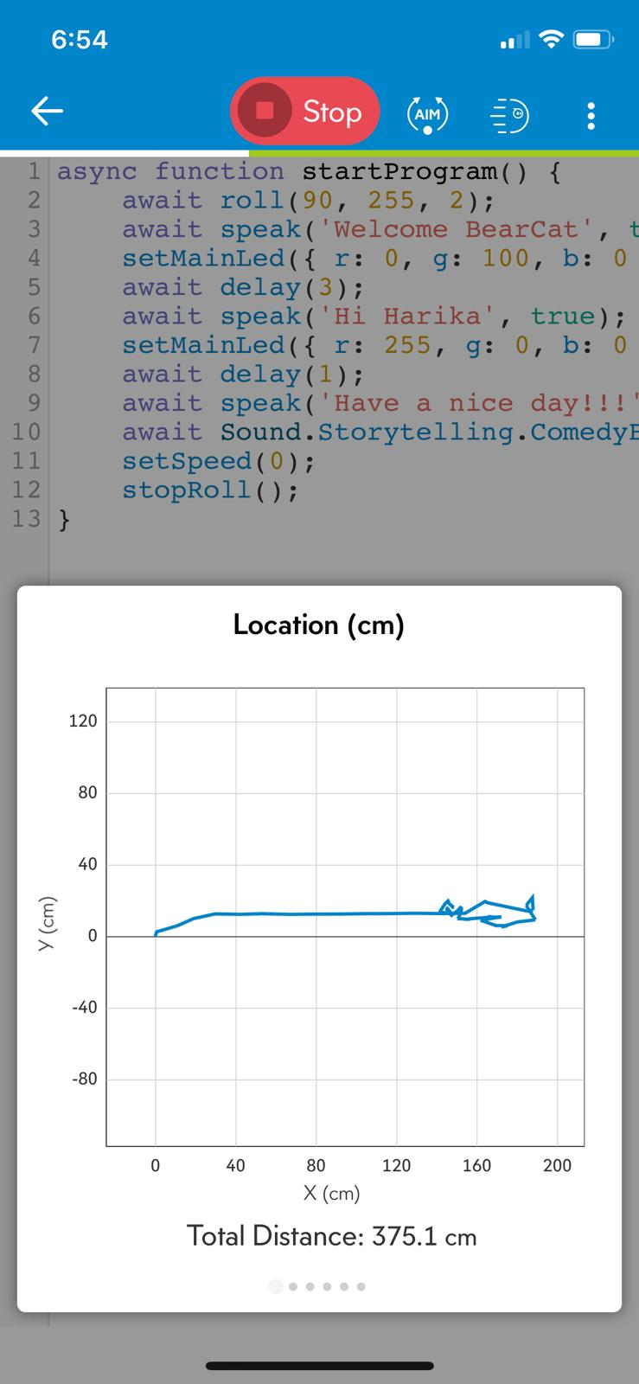
OUTPUT
Harika Naidu

Slide 24
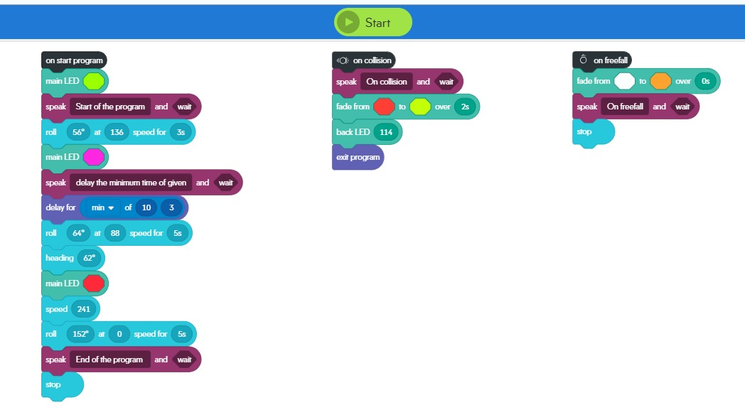
Sphero mini using blocks
Sai Tejaswini Narne

Slide 25
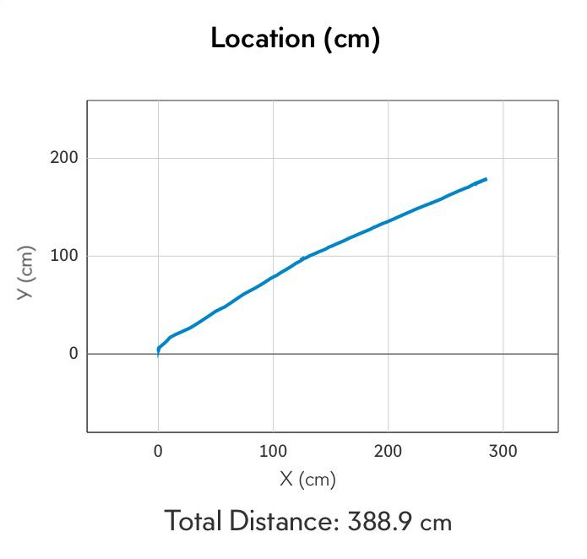
Shpero mini using blocks - output
Sai Tejaswini Narne

Slide 26
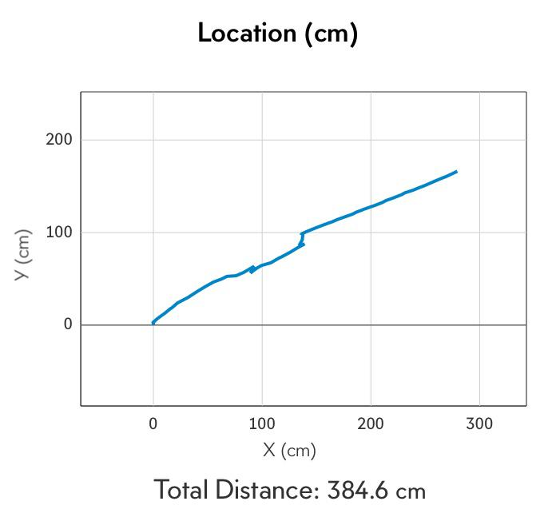
Shpero mini using blocks – output(on freefall)
Sai Tejaswini Narne

Slide 27
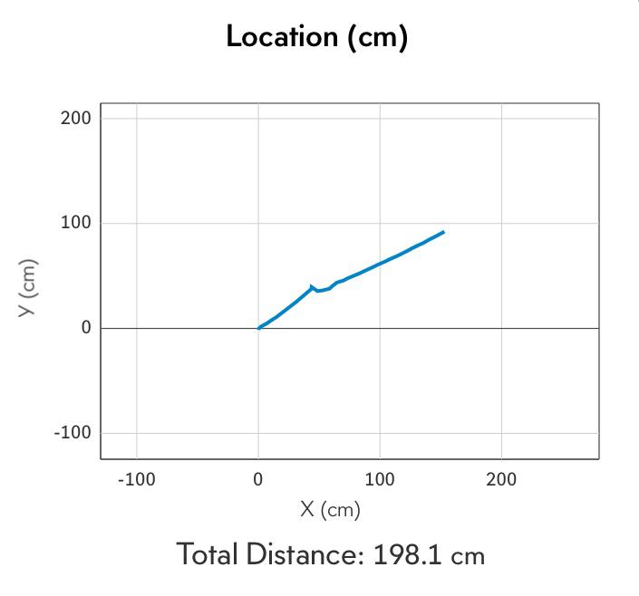
Shpero mini using blocks – output(on collision)
Sai Tejaswini Narne

Slide 28
Thank you….
ANY QUESTIONS?

